Slide 1

APK XML
arsc解析方法
杜兆喜 @ 南京
2015-4-21
zhaoxi.du@gmail.com

Slide 2
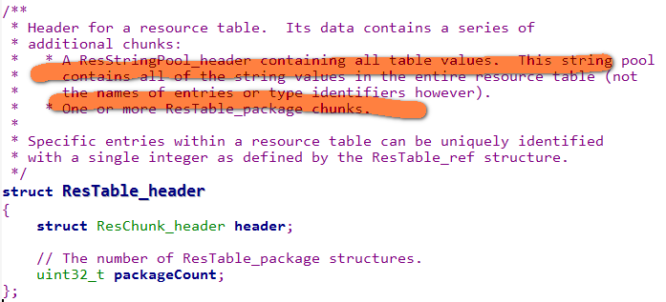
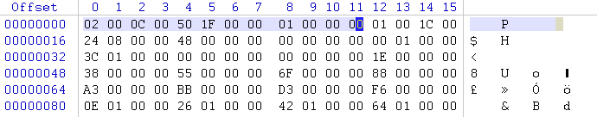
1、resources.arsc
packageCount=0x00000001

Slide 3
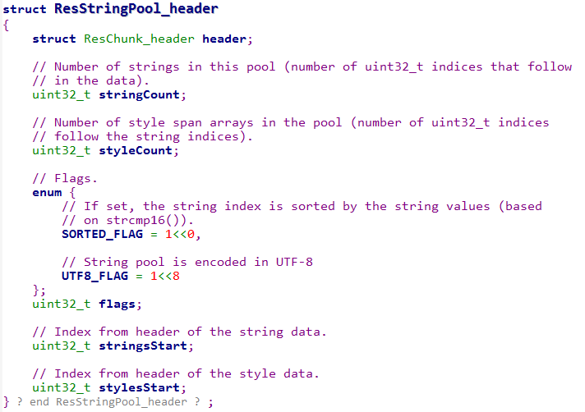
2、resources.arsc

Slide 4
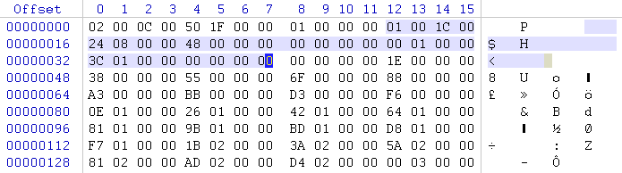
3、resources.arsc
stringCount =0x00000048
styleCount =0x00000000
flags =0x00000100 (UTF8)
stringsStart =0x00000038
stylesStart =0x00000000
既然是ResStringPool_header，紧跟着就是ResStringPool

Slide 5
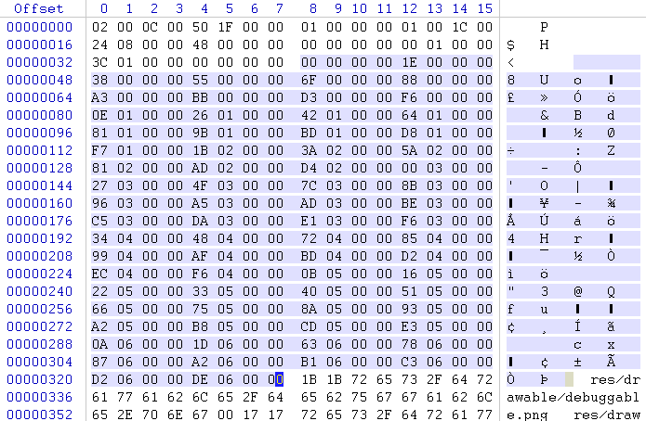
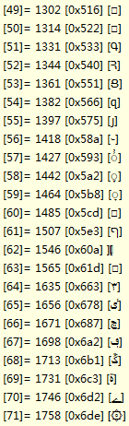
4、resources.arsc
m_stringOffsets数组

Slide 6
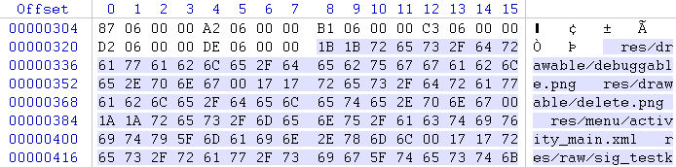
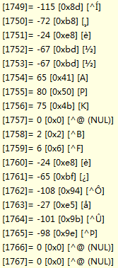
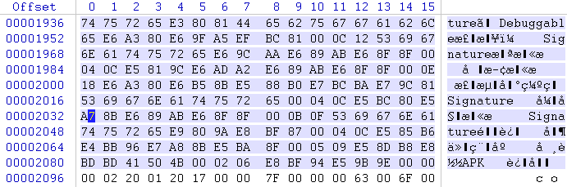
5、resources.arsc

Slide 7
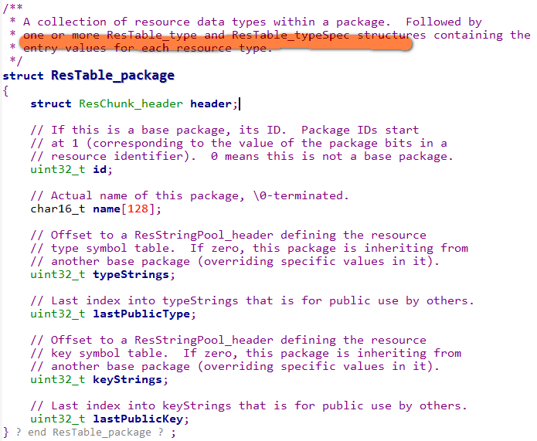
6、resources.arsc

Slide 8
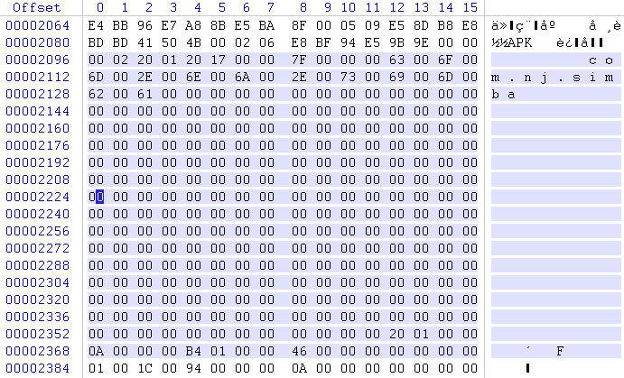
7、resources.arsc
id=0x0000007F
可得，解析包名的方法
typeStrings =0x00000120
lastPublicType =0x0000000A
keyStrings =0x000001B4
lastPublicKey =0x00000046

Slide 9
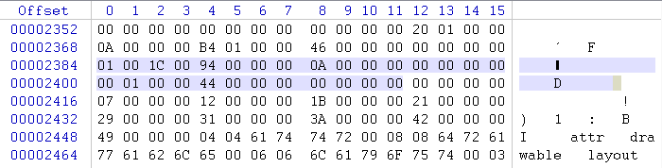
8、resources.arsc
stringCount =0x0000000A
styleCount =0x00000000
flags =0x00000100 (UTF8)
stringsStart =0x00000044
stylesStart =0x00000000
typeStrings
既然是ResStringPool_header，紧跟着就是ResStringPool

Slide 10
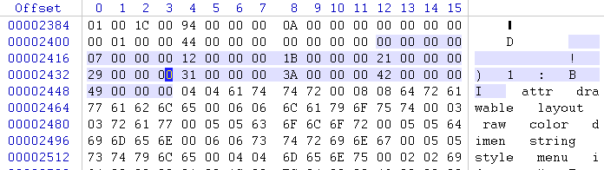
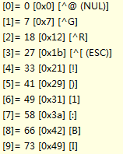
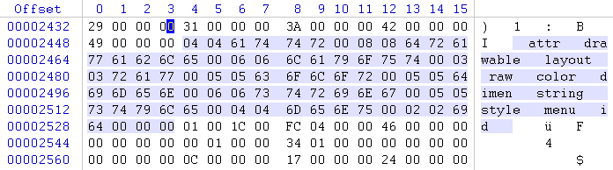
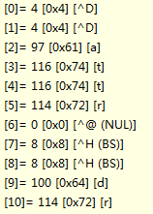


9、resources.arsc
stringOffsets
......
strings
......

Slide 11
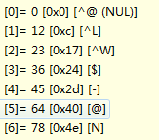
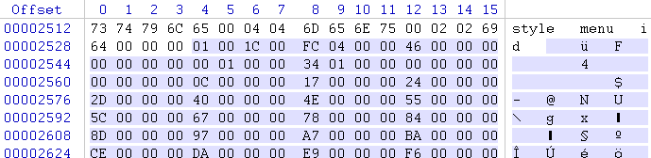

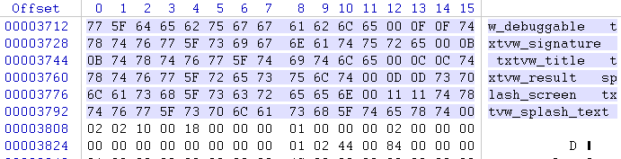

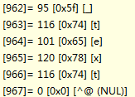

10、resources.arsc
stringsOffset =0x00000134
stringOffsets
flags=0x00000100
stringCount =0x00000046
......
strings
keyStrings

Slide 12
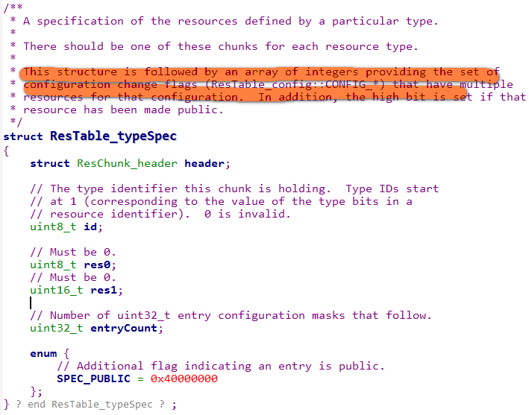
11、resources.arsc

Slide 13

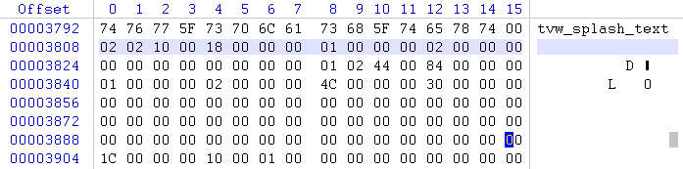
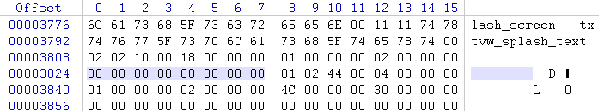

12、resources.arsc
mResId = id = 0x7F →
mResId = (0xff000000 & mResId) | id << 16;
attr
id =0x01
entryCount =0x00000002
mResId =0x7F010000
ResTable_typeSpec
entry
entry =0x0000000000000000

Slide 14
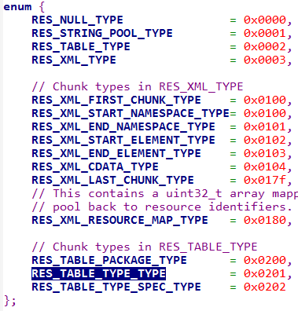
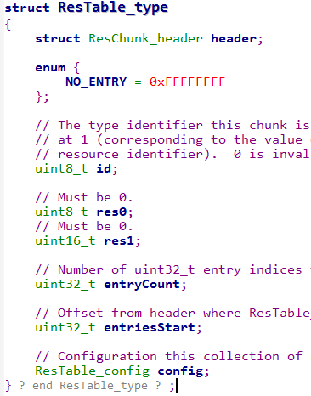
13、resources.arsc

Slide 15
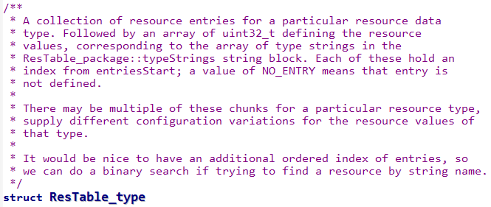
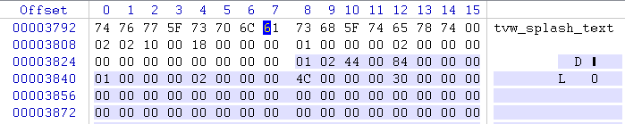
14、resources.arsc
ResTable_type
header
uint8_t id
uint8_t res0;
uint16_t res1;
uint32_t entryCount;
uint32_t entriesStart;
ResTable_config
ResTable_entry
id=0x01 res0=0x00 res1=0x0000 entryCount=0x00000002
entriesStart=0x0000004C

Slide 16
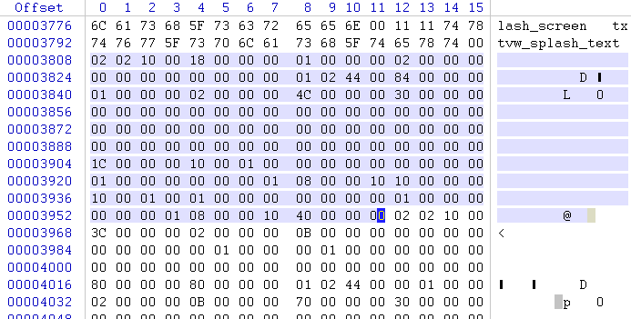

15、resources.arsc
ResTable_config
uint32_t size;
uint16_t mcc;
uint16_t mnc;
char language[2];
char country[2];
uint8_t orientation;
uint8_t touchscreen;
uint16_t density;
uint8_t keyboard;
uint8_t navigation;
uint8_t inputFlags;
uint8_t inputPad0;
uint16_t screenWidth;
uint16_t screenHeight;
uint16_t sdkVersion;
uint16_t minorVersion;
uint8_t screenLayout;
uint8_t uiMode;
uint16_t smallestScreenWidthDp;
uint16_t screenWidthDp;
uint16_t screenHeightDp;
size=0x00000030 mcc = mnc =... = 0
entryOffsets =

Slide 17
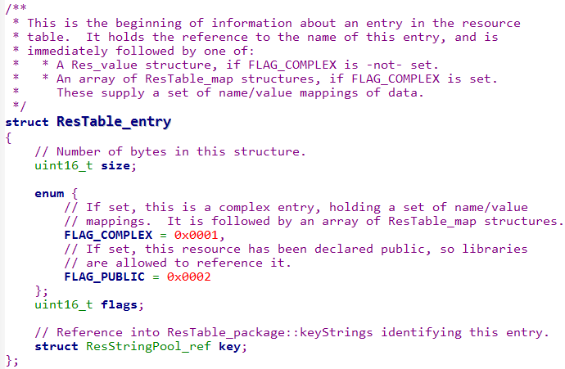
16、resources.arsc

Slide 18
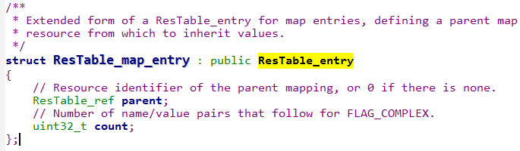
17、resources.arsc
如果是FLAG=0x0001代表是ResTable_map_entry，而不是ResTable_entry

Slide 19
17、resources.arsc
Attr （0x01）
两个entry
size=0x0010 flags=0x0001 key=0x00

Slide 20
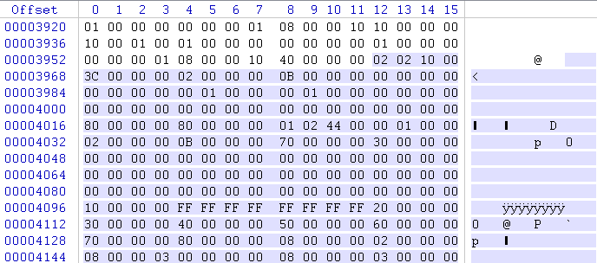
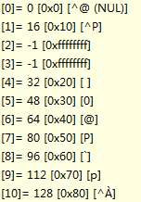
18、resources.arsc
entryOffsets
Drawable（0x02）
11个entry

Slide 21
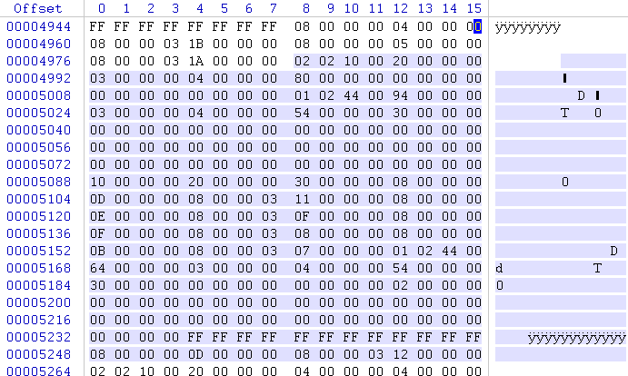

19、resources.arsc
entryOffsets
Layout（0x03）
4个entry

Slide 22
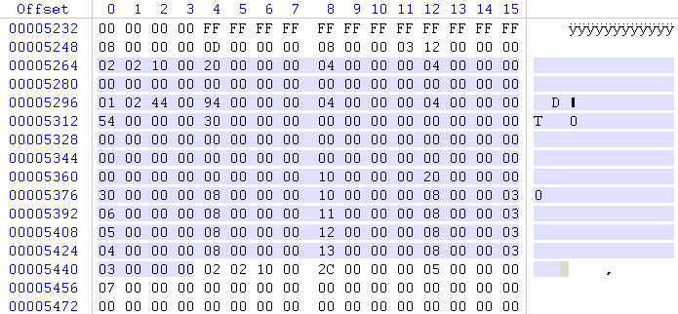

20、resources.arsc
entryOffsets
Raw（0x04）
4个entry

Slide 23
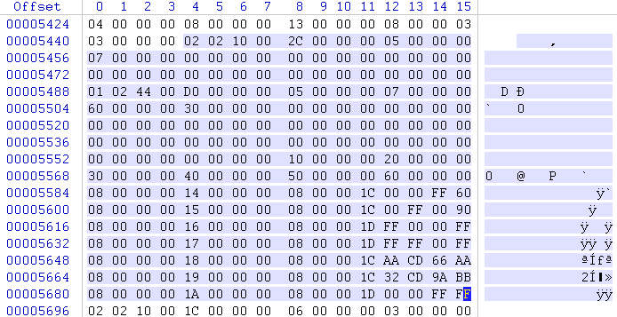
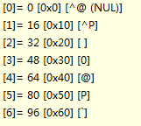
21、resources.arsc
entryOffsets
Color（0x05）
7个entry

Slide 24
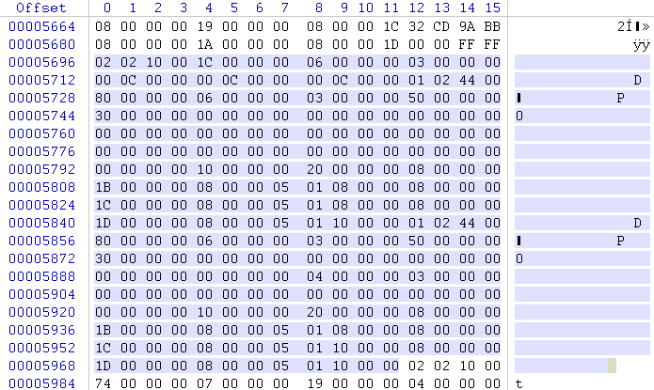

22、resources.arsc
entryOffsets
Diemen（0x06）
3个entry

Slide 25
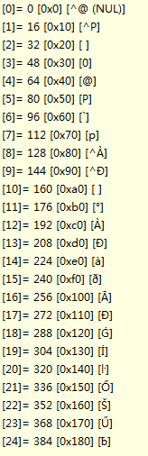
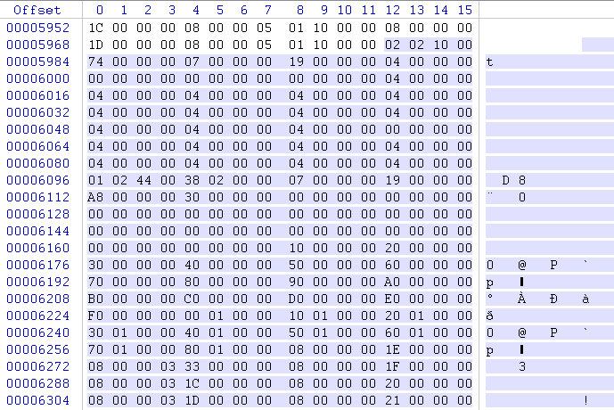
23、resources.arsc
entryOffsets
String（0x07）
25个entry

Slide 26
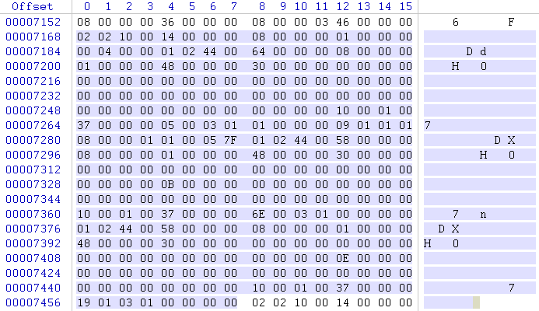
24、resources.arsc
entryOffsets
Style（0x08）
1个entry

Slide 27
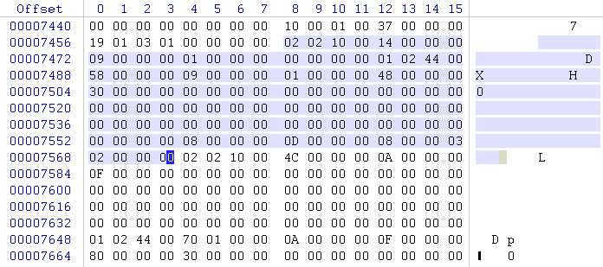
25、resources.arsc
entryOffsets
Menu（0x09）
1个entry

Slide 28
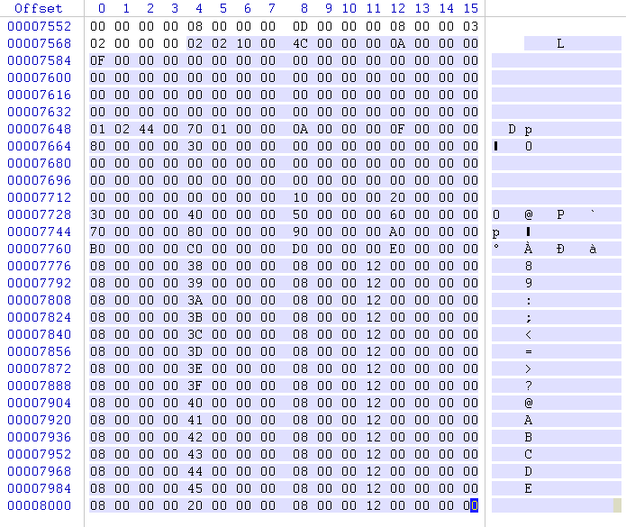
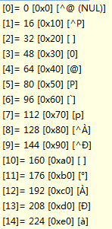
26、resources.arsc
entryOffsets
Id （0x0a）
15个entry

Slide 29
27、resources.arsc
解析结束！

